Slide 1
Lvl 4/5 Group 14 IMDCGD111-16YRD
Alex Polley, Henry Crofts and Michael Curtis

Slide 2
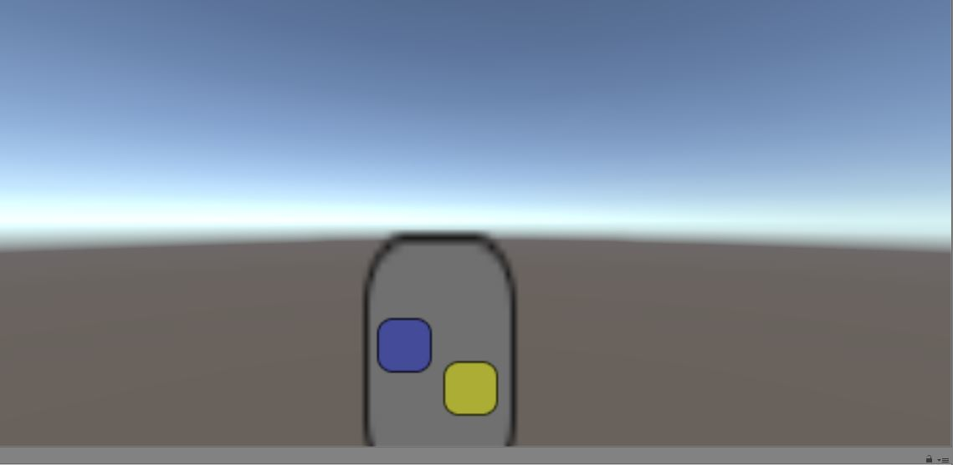
Concepts from Last Presentation
Friction Game
Twitch mechanic
Players must move their piece across a pathway with varying resistances
The resistance is overcome by rapid tapping on the screen
First player to reach the end is the winner

Slide 3
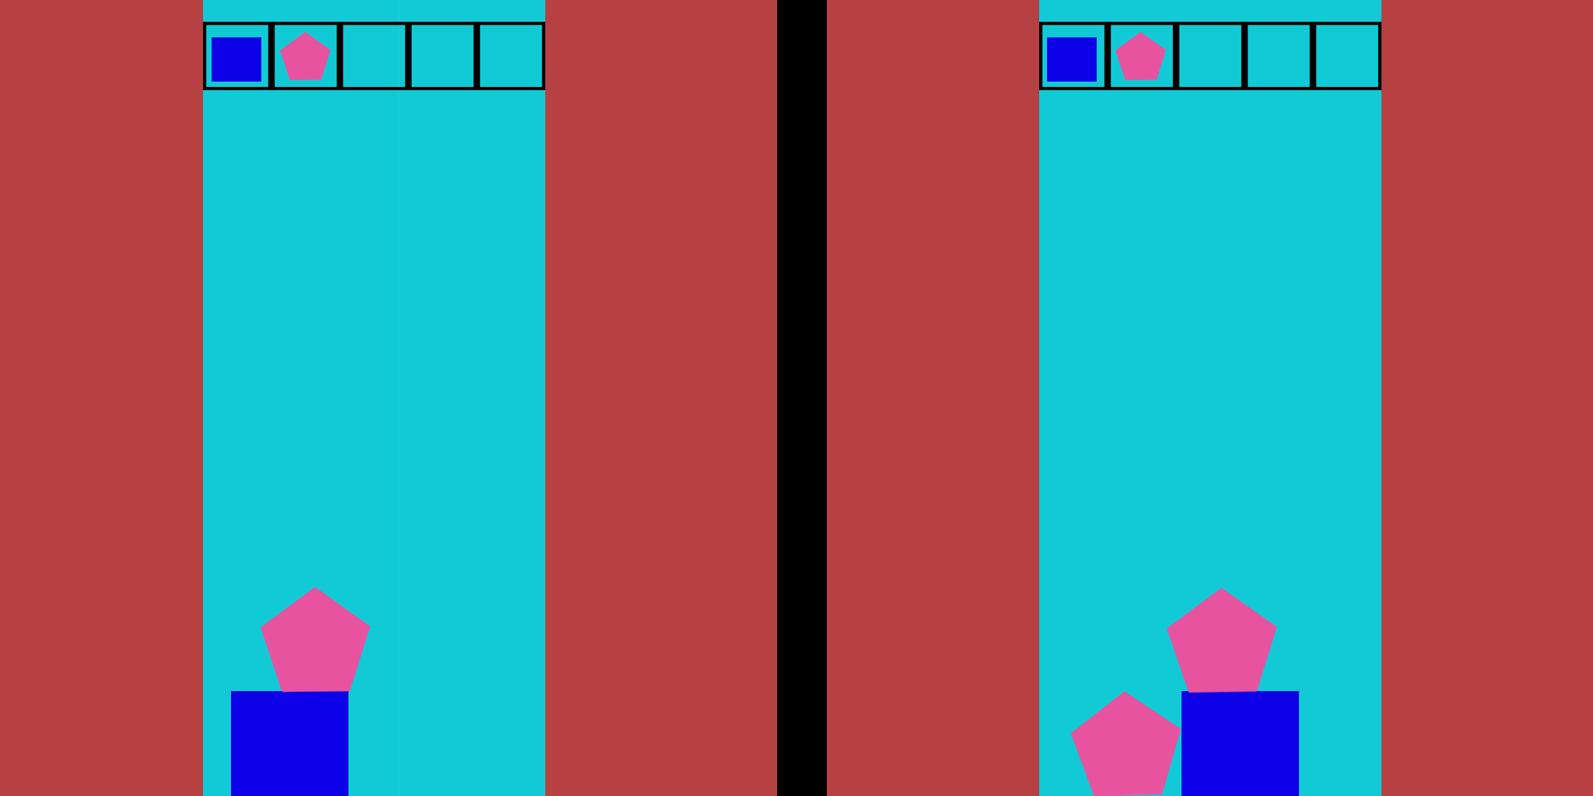
Concepts from Last Presentation
Gravity Game
Our gravity based game is a tower building game
Players must try and balance shapes they are given
If one player chooses a shape the other player must also use that shape

Slide 4
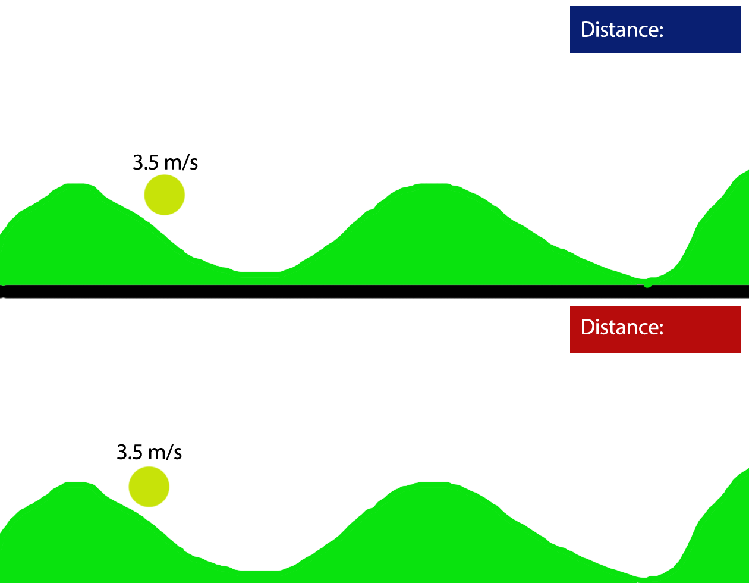
New Concept

Slide 5
Demographic
Male Teenagers 13- 18
Already have an interest in competition which often increases with age
Teens both male and female are interested in new experiences that can happen through gameplay
(Schell 101,103)

Slide 6
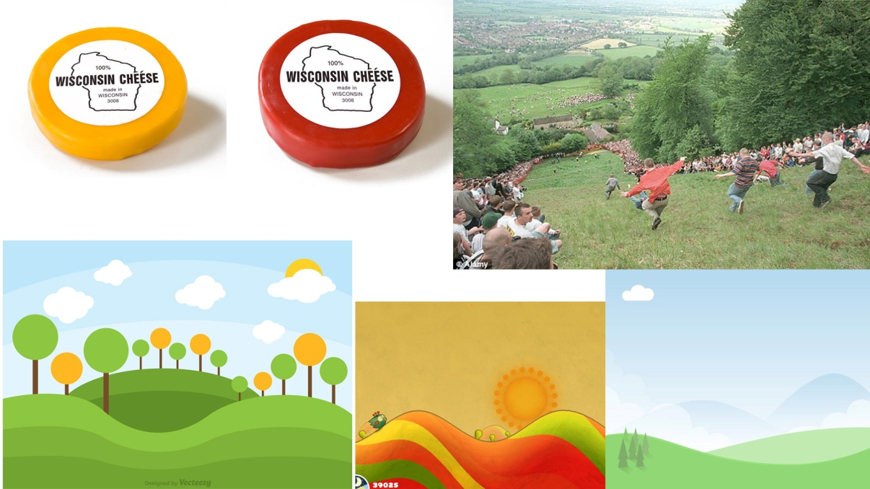



Art Style

Slide 7
Prototype
https://www.youtube.com/watch?v=B9Ke7sBfQWI&feature=youtu.be

Slide 8
Going Forward
Update Player Movement
Playtesting
Affordances

Slide 9
Management
Henry Crofts : 35 Hours
Michael Curtis: 18 Hours
Alex Polley: 20 Hours

Slide 10
Questions?

